Slide 1
Communication in Smart Grid

Slide 2
Data communication systems are essential in any modern power system and their importance will only increase as the Smart Grid develops.
he communication channel could be a dedicated link between the Source and Destination or could be a shared medium

Slide 3
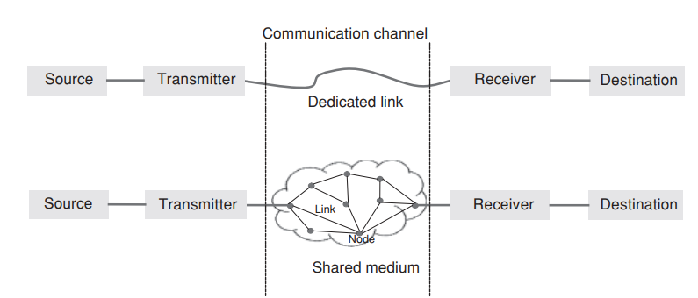

Slide 4
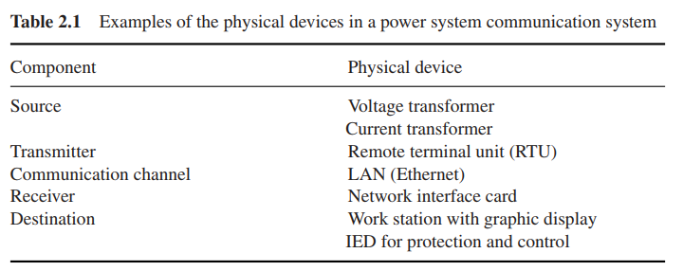

Slide 5
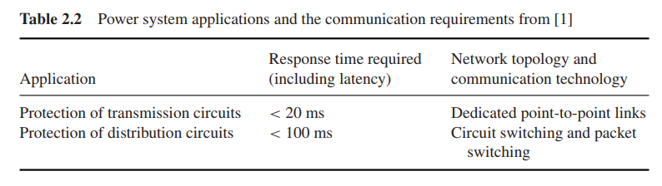

Slide 6
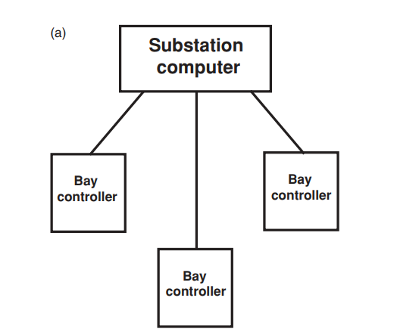
Star Connection

Slide 7
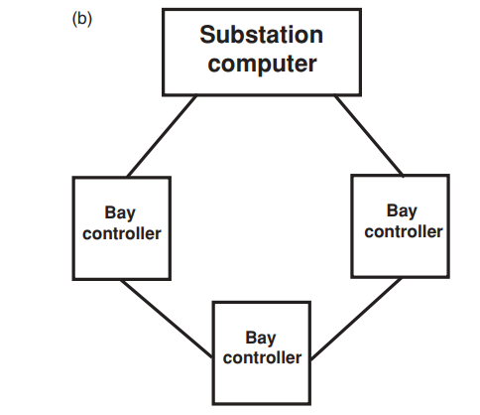
Ring Connection

Slide 8
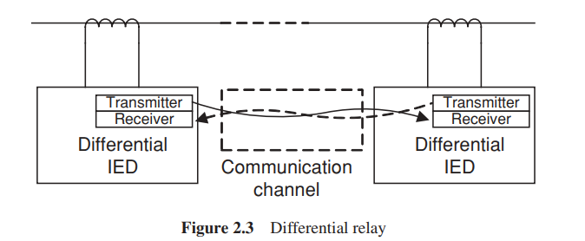

Slide 9
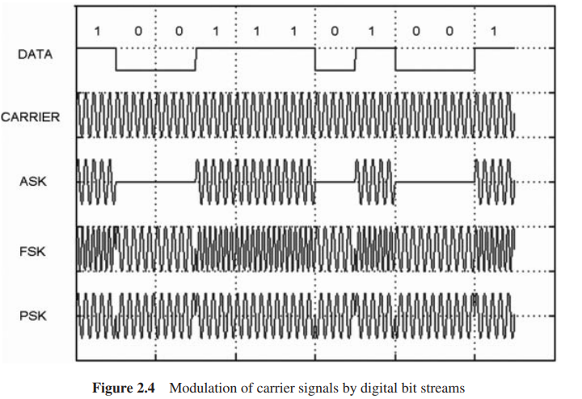

Slide 10
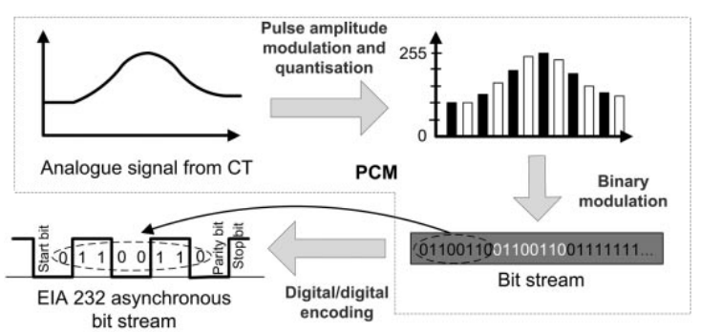

Slide 11
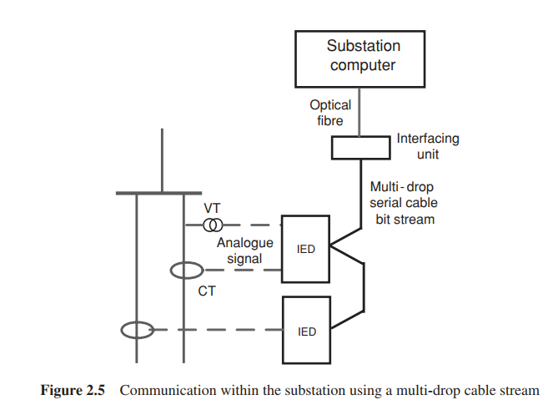

Slide 12
Circuit switching
In circuit switching, a dedicated physical connection is set up for the exclusive use of Source and Destination during the communication session. Nodes and links allocated for a communication session cannot be used by any Source/Destination other than the two involved in the communication session.

Slide 13
Message switching
In message switching, the Source sends a message to a node. A message could be measurement data collected by a sensor or a control function. The node stores the data in its buffer. When the entire message has been delivered to the node, it then looks for a free link to another node and then sends the data to this node.

Slide 14
Packet switching
Packet switching dominates in today’s data communication networks for reasons of economy and reliability. A message is transmitted after breaking it into suitably sized blocks, called packets. When traversing network adapters, Switches, Routers and other network nodes, packets are buffered and queued, resulting in variable delay and throughput depending on the traffic load in the network.

Slide 15
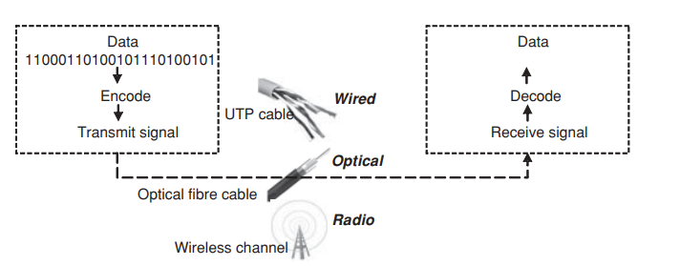

Slide 16
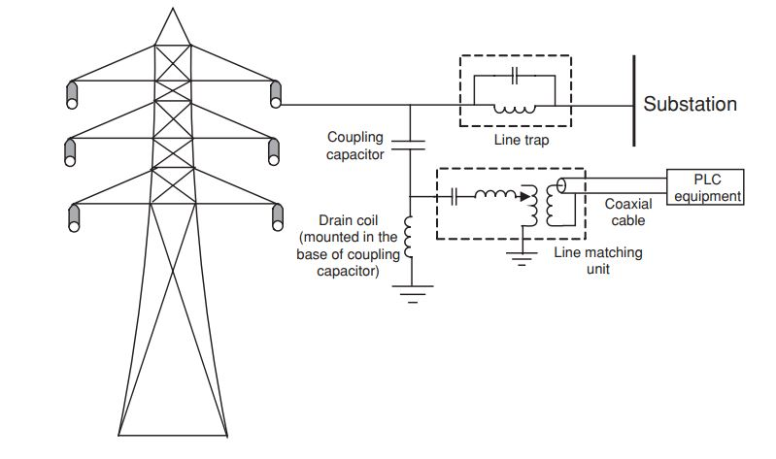
Open wire

Slide 17
Twisted pair
Unshielded twisted pair (UTP) cables are used extensively in telecommunication circuits.
A Digital Subscriber Line (DSL) allows the transmission of data over ordinary copper twisted pair telephone lines at high data rates to provide broadband services. A variant of DSL, Asymmetric DSL or ADSL, is a commonly used technology for broadband services to homes.

Slide 18
Coaxial cables
In coaxial cables a shielded copper wire is used as the communication medium. The outer coaxial conductor provides effective shielding from external interference and also reduces losses due to radiation and skin effects. Bit rates up to 10 Mbps are possible over several metres.

Slide 19
Optical fibre
Optical fibre transmission is used both inside substations and for long-distance transmission of data. Optical fibres are often embedded in the stranded conductors of the shield (ground) wires of overhead lines. These cables are known as OPtical Ground Wires (OPGW).

Slide 20
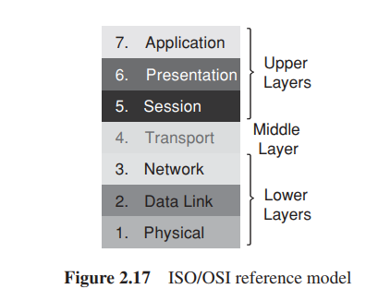
Protocol Layers and Their Service Models

Slide 21
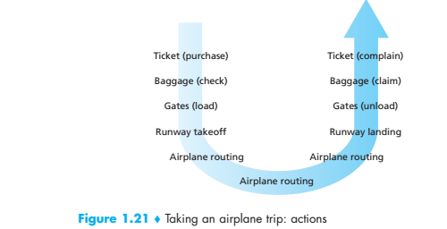

Slide 22
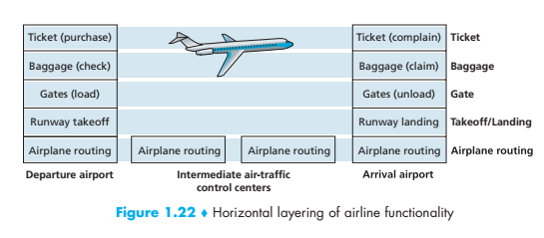

Slide 23
Application Layer
The ‘Open System Interconnection model’ developed by the International Standard Organisation (ISO/OSI) [2,4] is a protocol architecture which consists of seven layers that describe the tasks associated with moving information from Source to Destination through a communication network
An application-layer protocol defines how an application’s processes, running on different end systems, pass messages to each other.
The types of messages exchanged, for example, request messages and response messages
The Internet’s application layer includes many protocols, such as the HTTP protocol (which provides for Web document request and transfer), SMTP (which provides for the transfer of e-mail messages), and FTP (which provides for the transfer of files between two end systems)

Slide 24
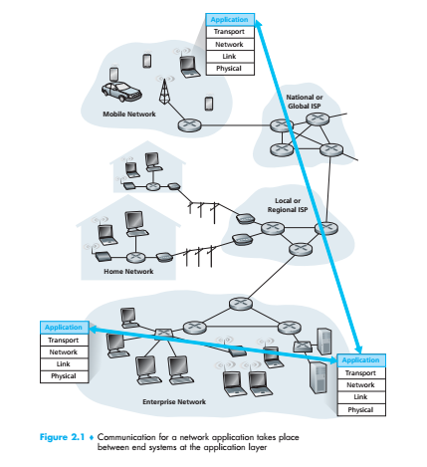

Slide 25
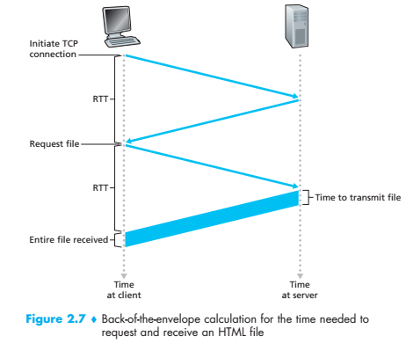

Slide 26
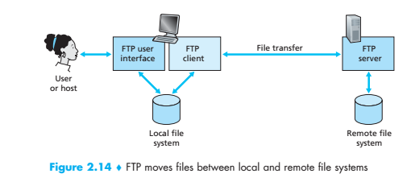

Slide 27
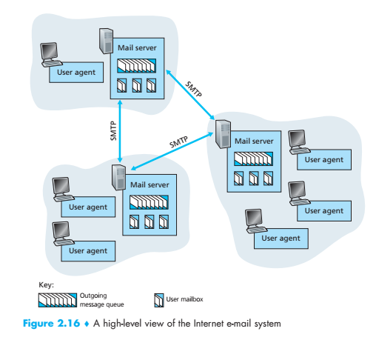

Slide 28
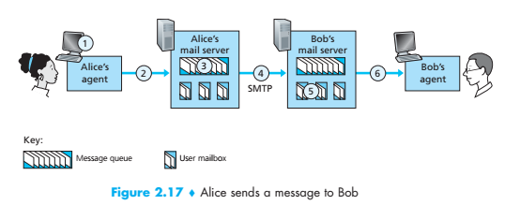

Slide 29
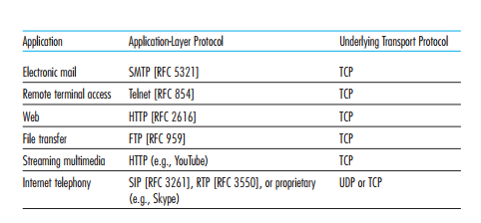

Slide 30
The HyperText Transfer Protocol (HTTP), the Web’s application-layer protocol is at the heart of the Web. It is defined in [RFC 1945] and [RFC 2616]. HTTP is implemented in two programs: a client program and a server program. The client program and server program, executing on different end systems, talk to each other by exchanging HTTP messages. HTTP defines the structure of these messages and how the client and server exchange the messages

Slide 31
Transport Layer
TCP(Transmission Control Protocol) provides a delivery of application-layer messages to the destination and flow control (that is, sender/receiver speed matching). TCP also breaks long messages into shorter segments and provides a congestion-control mechanism, so that a source throttles its transmission rate when the network is congested

Slide 32
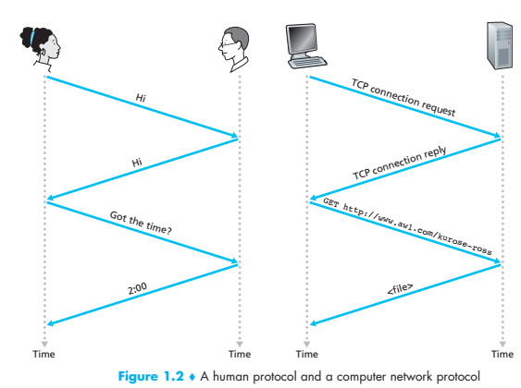

Slide 33
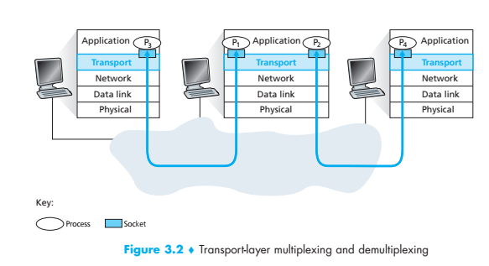

Slide 34
The UDP(User Datagram Protoco) protocol provides a connectionless service to its applications. This is a no-frills service that provides no reliability, no flow control, and no congestion control.
we’ll refer to a transport-layer packet as a segment.

Slide 35
Network Layer
The Internet’s network layer is responsible for moving network-layer packets known as datagrams from one host to another.
The Internet’s network layer includes the celebrated IP Protocol, which defines the fields in the datagram as well as how the end systems and routers act on these fields. There is only one IP protocol, and all Internet components that have a network layer must run the IP protocol.

Slide 36
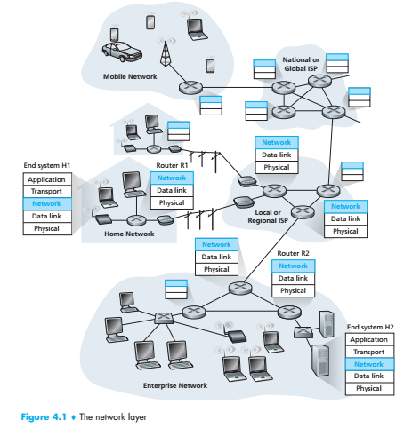

Slide 37
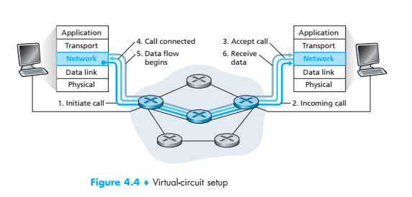

Slide 38
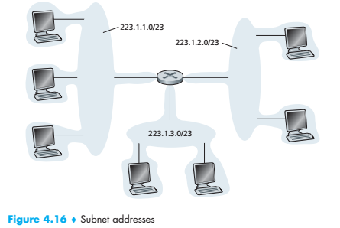

Slide 39
Link Layer
The Internet’s network layer routes a datagram through a series of routers between the source and destination. To move a packet from one node (host or router) to the next node in the route, the network layer relies on the services of the link layer.
Examples of link layer protocols include Ethernet, WiFi, and the cable access network’s DOCSIS protocol. As datagrams typically need to traverse several links to travel from source to destination, a datagram may be handled by different link-layer protocols at different links along its route

Slide 40
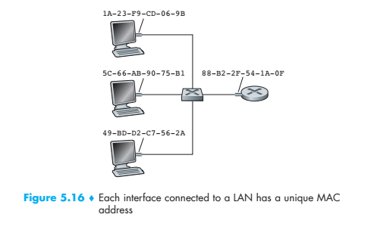

Slide 41
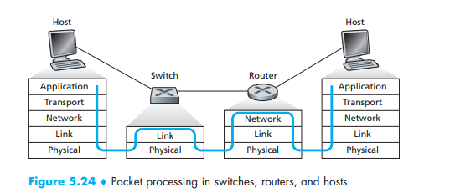

Slide 42
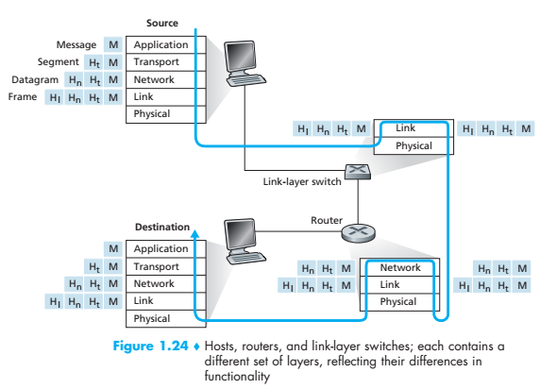

Slide 43
Physical Layer
While the job of the link layer is to move entire frames from one network element to an adjacent network element, the job of the physical layer is to move the individual bits within the frame from one node to the next. The protocols in this layer are again link dependent and further depend on the actual transmission medium of the link (for example, twisted-pair copper wire, single-mode fiber optics). For example, Ethernet has many physical-layer protocols: one for twisted-pair copper wire, another for coaxial cable, another for fiber, and so on. In each case, a bit is moved across the link in a different way.

Slide 44
